Slide 1
End-to-End Machine Learning with ML.NET and Azure CodeCampNYC 2018 Luis Quintanilla

Slide 2





Hello ☺
Artificial Intelligence Consultant
lqdev@outlook.com
http://luisquintanilla.me
@ljquintanilla
https://github.com/lqdev
Notes:
Consultant
Interests: Artificial Intelligence, IoT and all things .NET
GitHub: lqdev
Twitter: @ljquintanilla
Blog: luisquintanilla.me

Slide 3
Code
http://bit.ly/codecampnyc2018

Slide 4
Agenda
01
What is Machine Learning?
02
From Data to Machine Learning
03
Building a Model
04
Deploying a Model
Notes:
What is Machine Learning
From Data to Machine Learning
Building a Model
Deploying a Model

Slide 5
What is Machine Learning?

Slide 6
AI vs ML
Artificial Intelligence
Machine Learning
Notes:
AI
Automating tasks usually performed by humans
Rules-Based Systems/Symbolic Programming
Example: If-Then
Machine Learning
Finding useful data representations within a predefined space
Example: Linear Regression

Slide 7
Machine Learning Tasks
Supervised Learning
Unsupervised Learning
Regression
Classification
Clustering
What is the price of a home in NYC?
Is this a dog or cat?
Customer segments in a database
Notes:
Supervised Learning
Regression – What is the price of a home in NYC?
Classification – Is this a dog or a cat?
Unsupervised Learning
Clustering – What kinds of topics are present in this database

Slide 8
Classification Example
Training Data
New Data
Species | Is Independent | Class
Canine | False | Dog
Feline | True | Cat
Feline | True | Cat
Canine | False | Dog
Canine | True | Dog
Species | Is Independent
Canine | False
Prediction
Features
Label
Class
Dog

Slide 9
From Data to Machine Learning

Slide 10

The Machine Learning Process

Slide 11

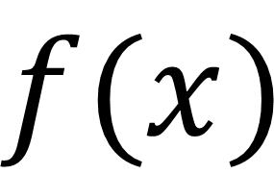
What is a model?
True
$$f(x)$$
False
Input
Model
Output

Slide 12
Building a Machine Learning Model

Slide 13
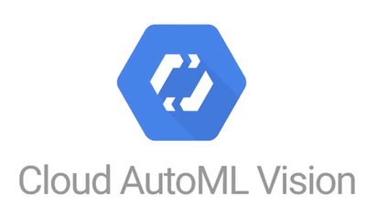













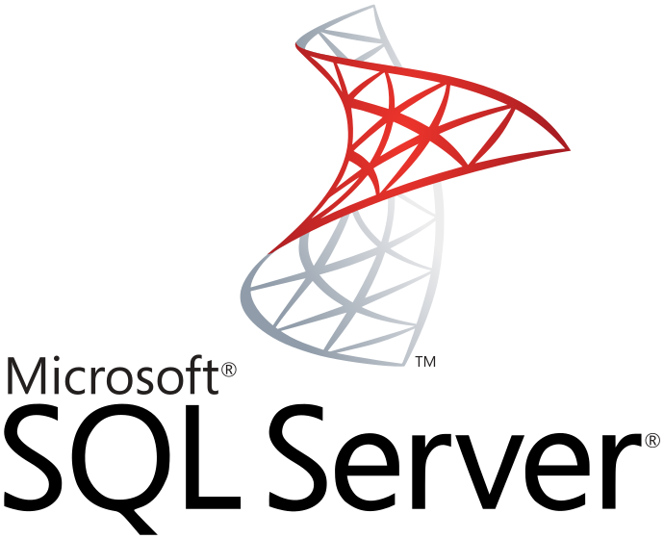

Machine Learning Tools

Slide 14



Automated vs. Custom
Automated
Custom

Slide 15


Slide 16

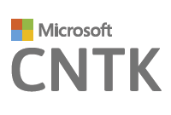
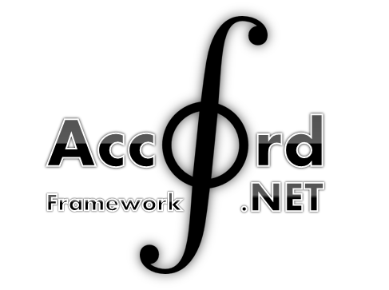

.NET Tools

Slide 17




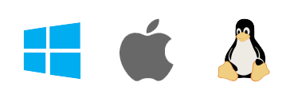
ML.NET
Framework for Machine Learning
Proven & Extensible
.NET Standard
Open Source
Cross Platform
Notes:
Framework for custom Machine Learning
.NET Standard
Proven & Extensible
Open Source
Cross Platform

Slide 18
What can you do with ML.NET?
Transformations
Missing Values
Feature Selection
Learners
SVM
K-Means
Misc
Data Loaders
Evaluators
Extensions
Normalization
Boosted Trees
TensorFlow
CNTK
ONNX
Accord.NET
Notes:
Build and train ML.NET Models
Run ANY Model

Slide 19
Iris Classification Model
Class Library
Azure
Model
Azure Container Instances Application
Azure Functions Application
Console Application

Slide 20
Demo: Training a Model

Slide 21
Consuming a Machine Learning Model

Slide 22




Model Consumption Methods
Desktop
Mobile
Web
IoT
Notes:
Desktop
Mobile
Web
IoT
Wherever .NET Runs*

Slide 23



Deploying to the Web
Virtual Machines
Containers
Serverless
Notes:
https://dzone.com/articles/virtual-machines-vs-containers-vs-serverless-compu

Slide 24
Demo: Deploying a Model to Azure Container Instances

Slide 25
Demo: Deploying a Model to Azure Functions

Slide 26
Resources
https://docs.microsoft.com/en-us/azure/container-instances/
https://docs.microsoft.com/en-us/azure/azure-functions/functions-run-local
https://blogs.msdn.microsoft.com/dotnet/2018/10/08/announcing-ml-net-0-6-machine-learning-net/

